Slide 1

Annual report on use of force by Dayton Police
Presented by Didier Niyomukiza Aug 2022

Slide 2

This presentation will reveal:
If use of force is raising
Chances that police will use force based on race?
How gender affects arrest resistance
Age group affected the most victims?

Slide 3
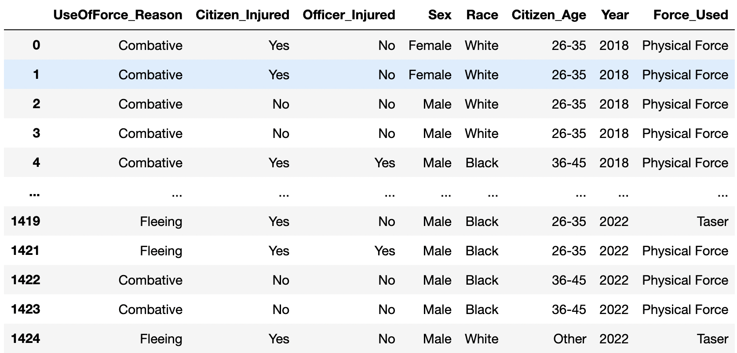

Dataset overview

Slide 4
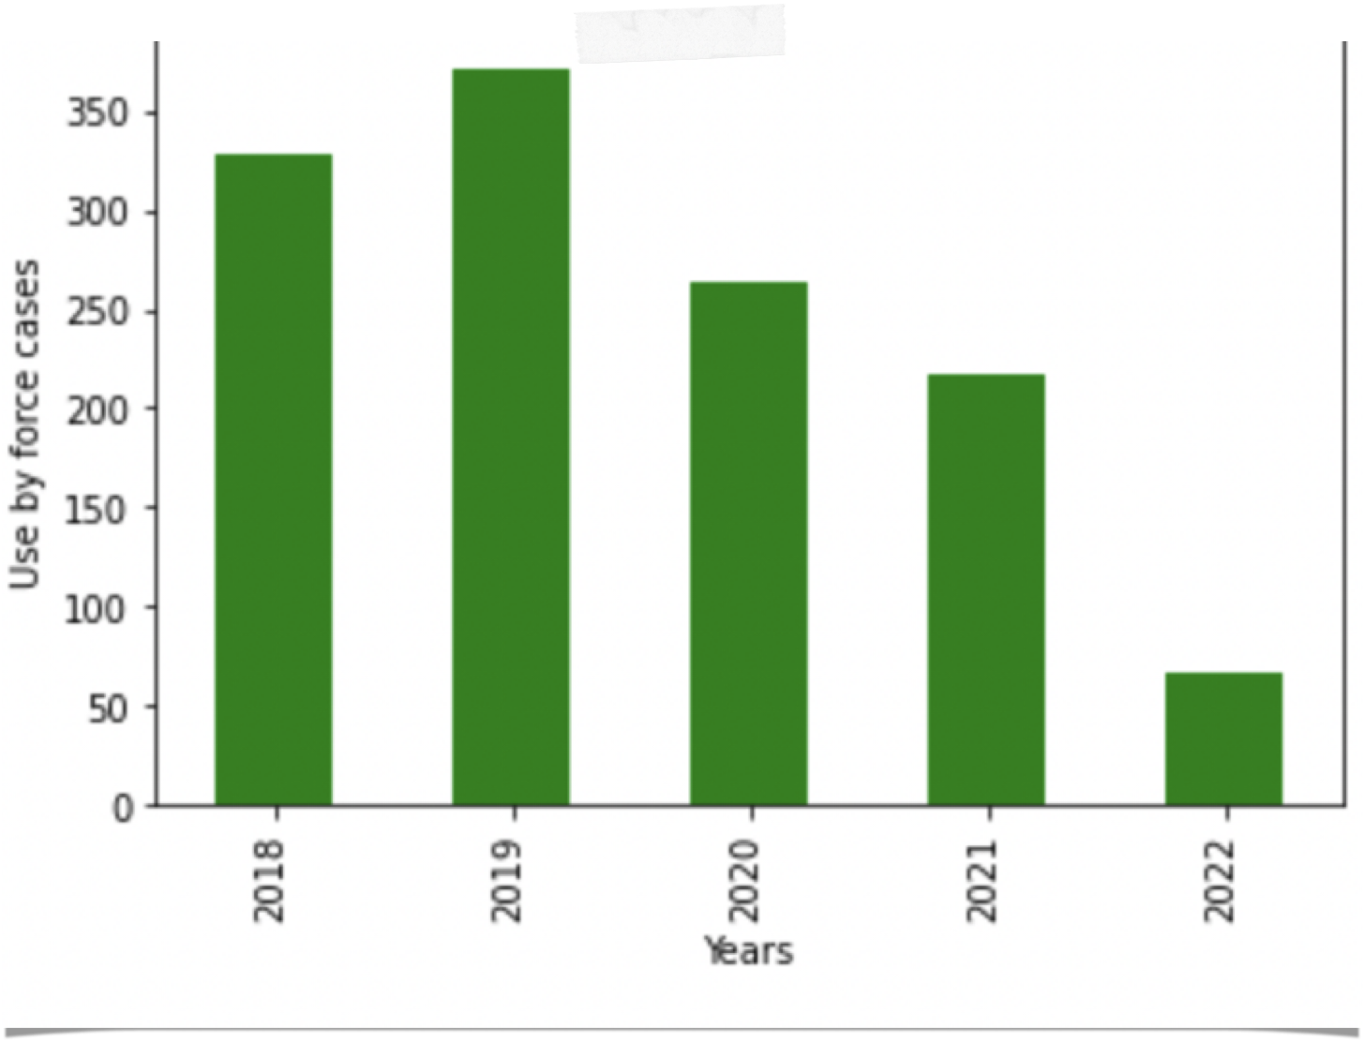
The use of force on raise?
Where are we today?

Slide 5
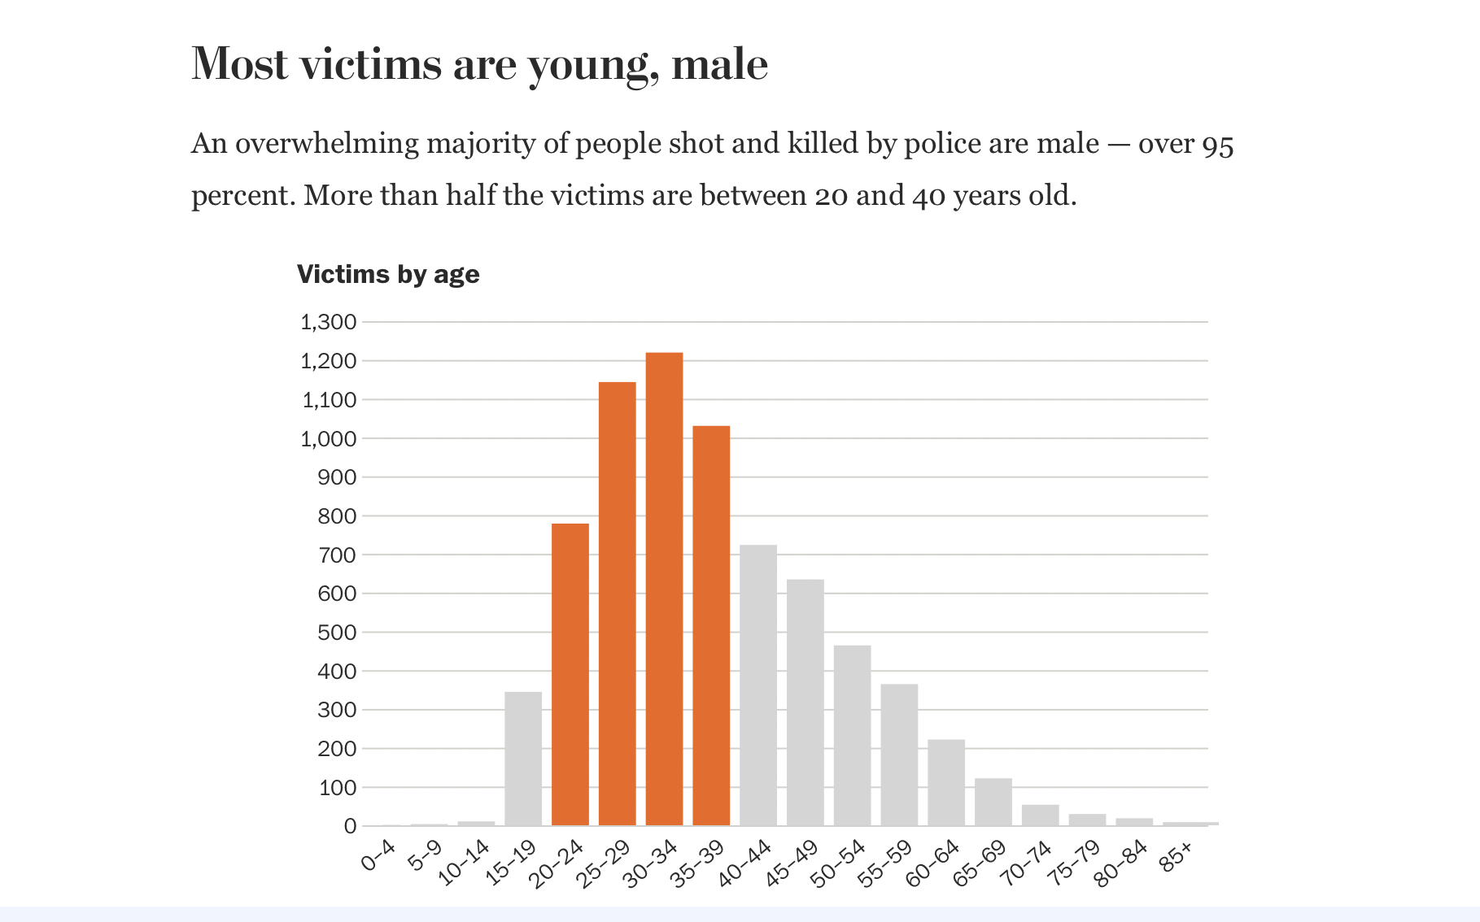
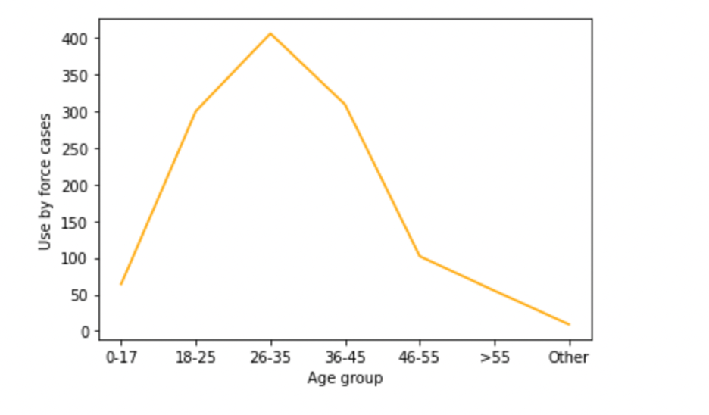
Young male are the most victims
Washington post database 2022

Slide 6
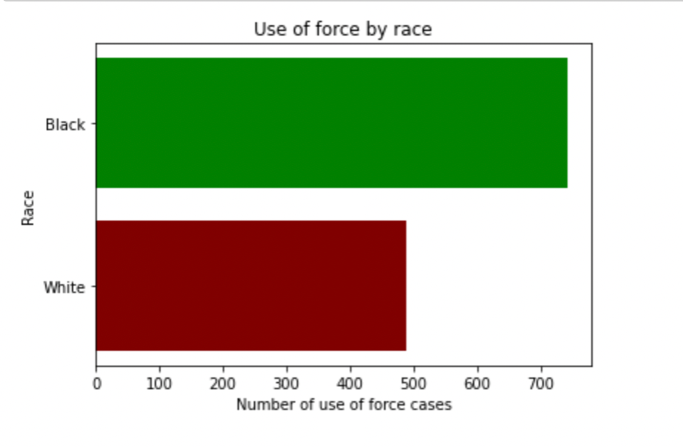
Force is used more black than white community
Probability of a black male combating a police officer is 0.5 vs 0.4 for white

Slide 7
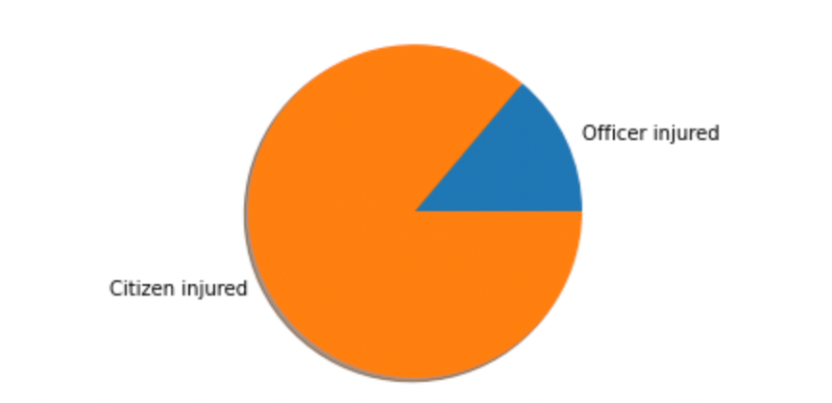
Police officers are victims, too

Slide 8
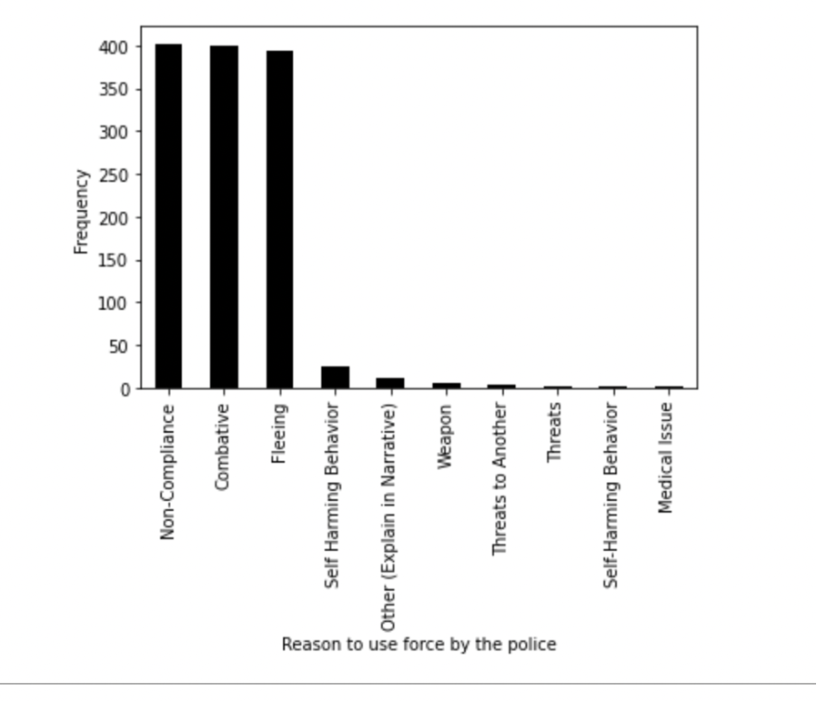
What prompted the police to use force?

Slide 9
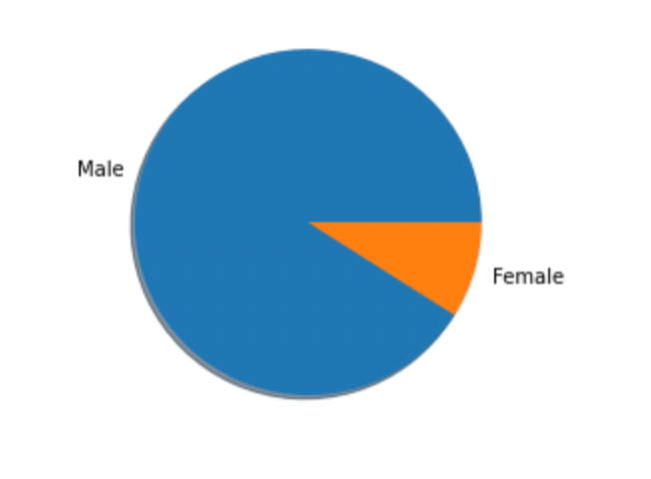
Arrest resistance by gender

Slide 10
End

